Slide 1
Methods 2 Classroom 11

Slide 2
TODAY
Linear regression:
Working with more than 1 predictor
Interactions
Optional: work on your portfolio

Slide 3


More than 1 predictor
Kid score example:
One predictor
Two predictors
Two predictors in R

Slide 4
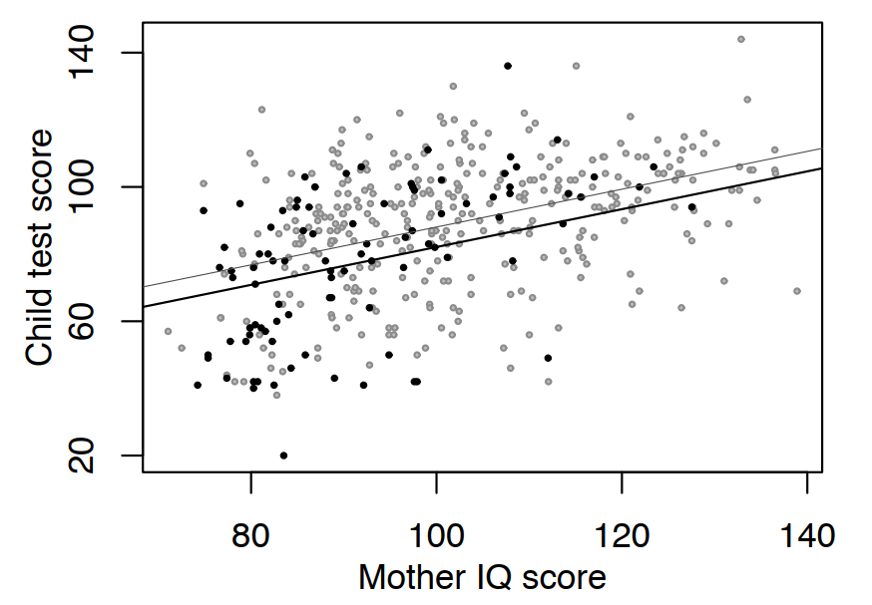
More than 1 predictor
Light dots: mothers finished high school
mom_hs = 1
Dark dots: mothers didn’t finish high school
mom_hs = 0

Slide 5
Regression with Interactions
Kid score example:
No interaction
With interaction
In R:
Interactions allow a model to be fit differently to different subgroups
That is the slope can vary between subgroups
Subgroup in Kid score example: whether the mother has completed high school or not

Slide 6
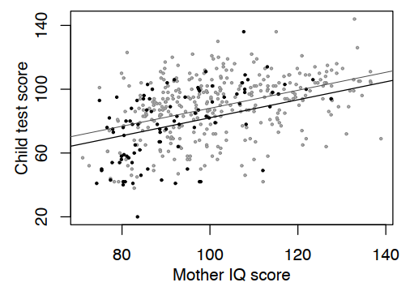
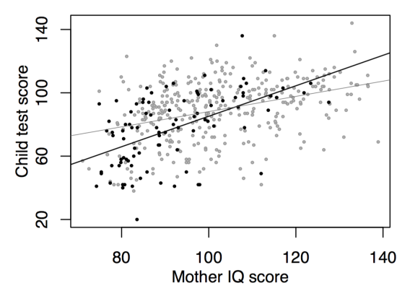
Regression with Interactions
Without interaction
With interaction

Slide 7
Exercises
Exercises from ROS
10.1
10.2
10.3
10.4
Link to the exercise notebook: https://classroom.github.com/a/zmno6ZGF

